Slide 1
RMS SOP
Bert Hu
SMD
Notes:
In 3-raw heading uses font 84, 1 raw and 2-raws use font 88

Slide 2
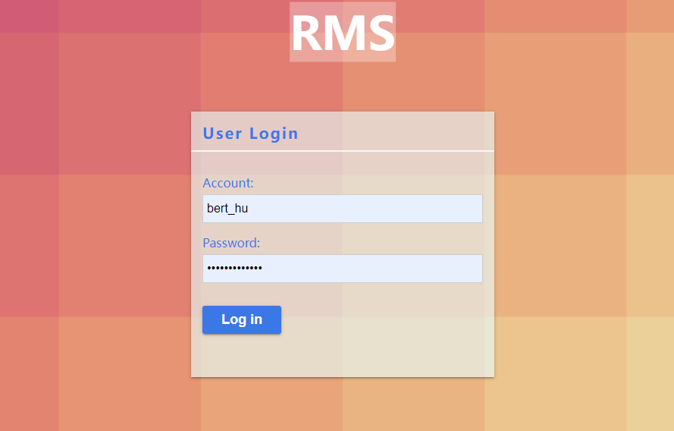
1.Login
Log in to the system using your domain account
Username: Mailbox prefix (Such as rainy_xu@usiglobal.com, The username is rainy_xu）
Password: The password for turning on the computer
If you do not have a domain account, please apply for a system account from the administrator

Slide 3
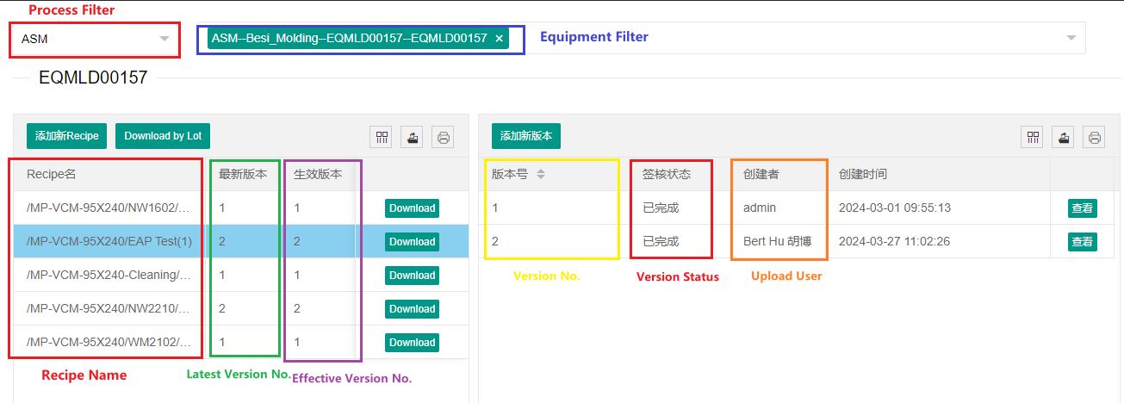
2.Recipe Manage – Version Manage
Only the Effective version can be downloaded to machine.

Slide 4
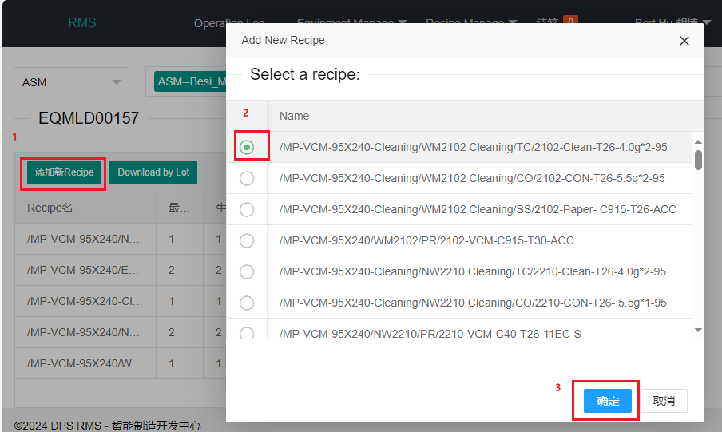
2.1Recipe Manage – Version Manage – Add new recipe(1/1)
If the recipe has already been uploaded, please go to ‘Add new version’

Slide 5
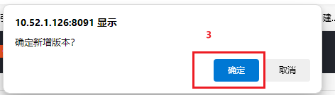
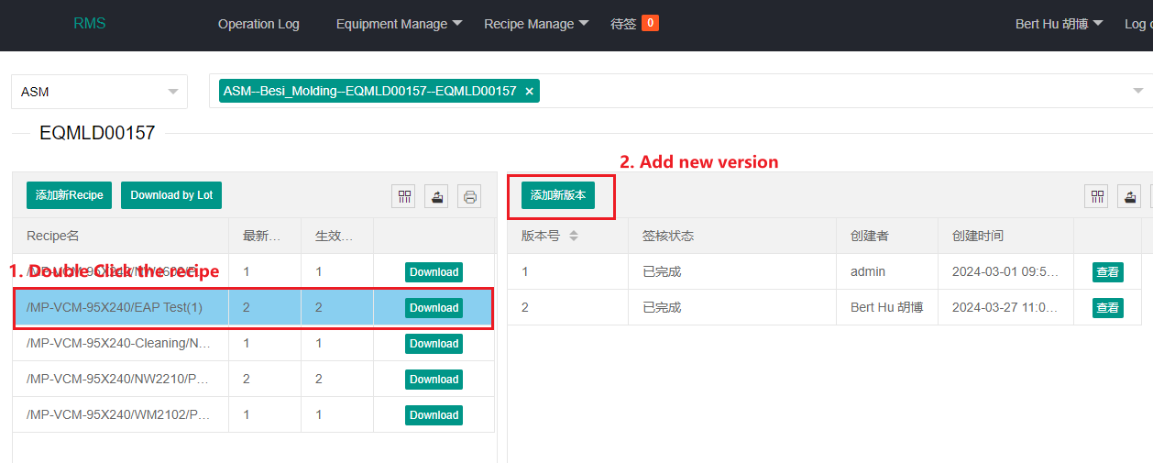
2.2Recipe Manage – Version Manage – Add new version(1/2)

Slide 6
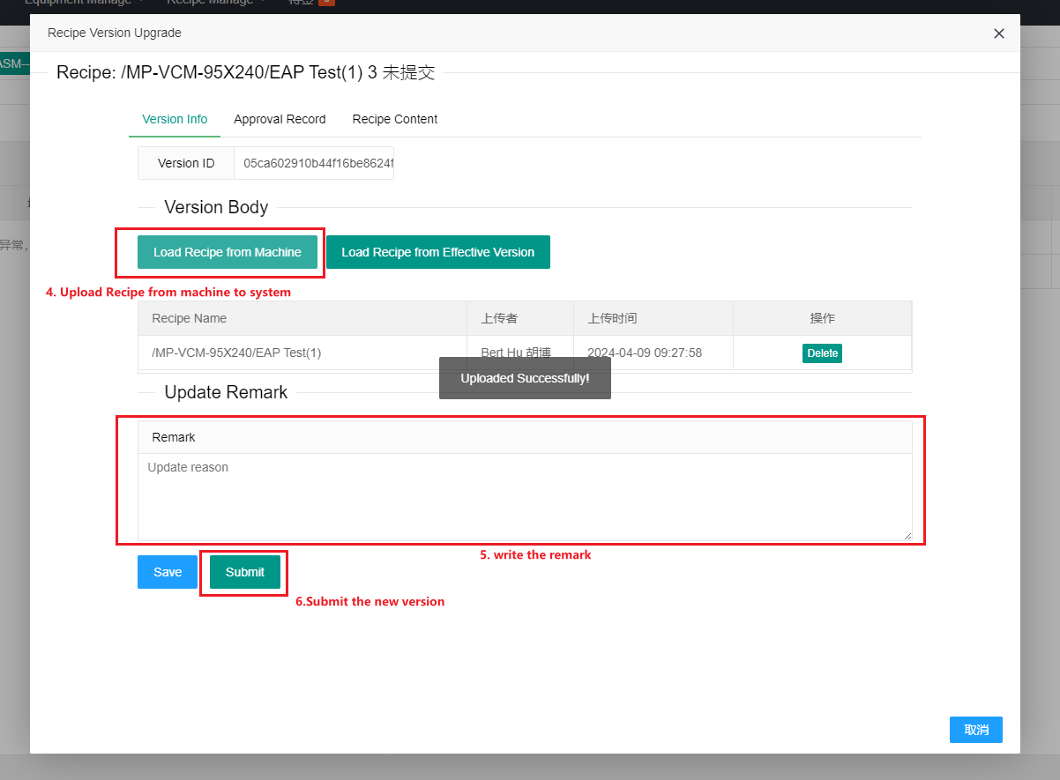
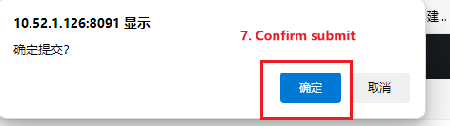
2.2Recipe Manage – Version Manage – Add new version(2/2)

Slide 7
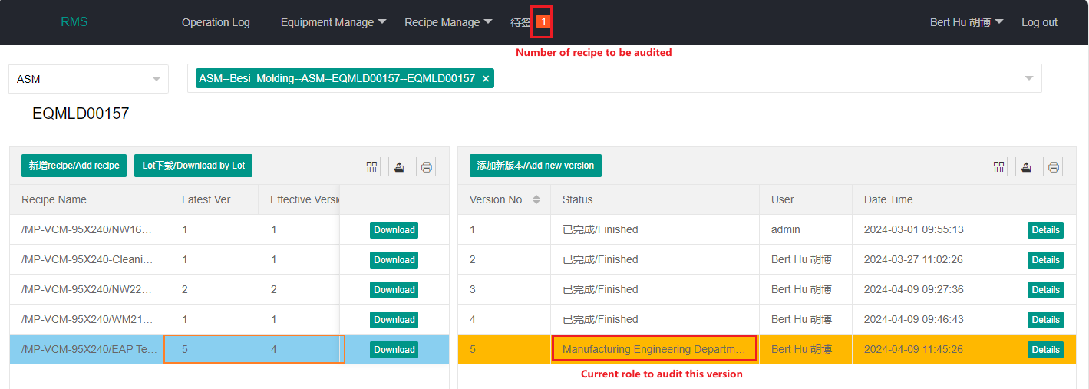
2.3 Recipe Manage – Version Audit – Version Approval(1/2)

Slide 8
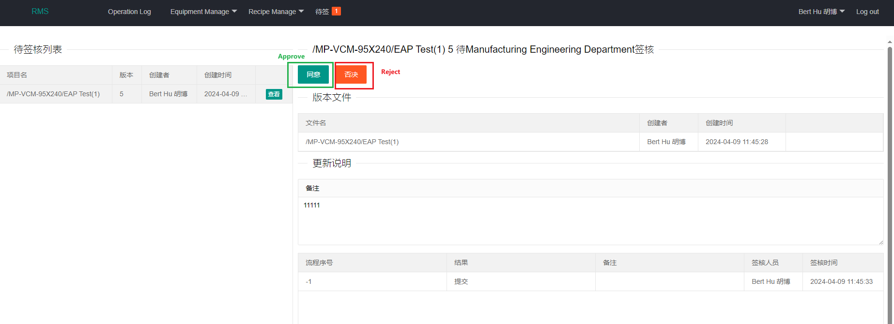
2.3 Recipe Manage – Version Audit – Version Approval(2/2)

Slide 9
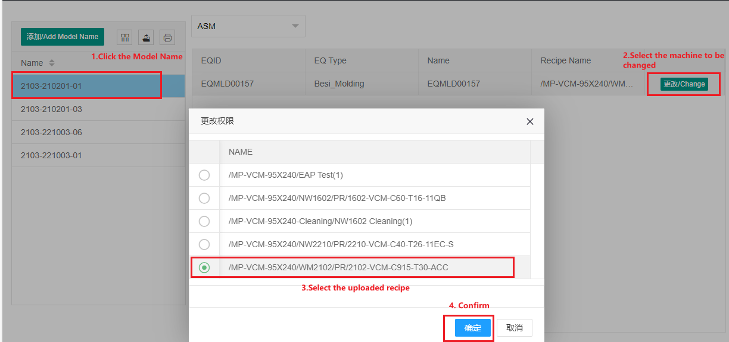
2.4 Recipe Manage – Model Name Link(1/1)

Slide 10
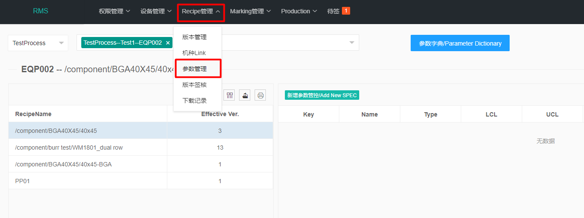
3.1 Parameter management (For Non-Secs machine)(1/3)
"Recipe Management" menu - > "Parameter Management“
*If you do not set it, you can not set the parameter SPEC.
*Machines of the same type share the reference dictionary.

Slide 11
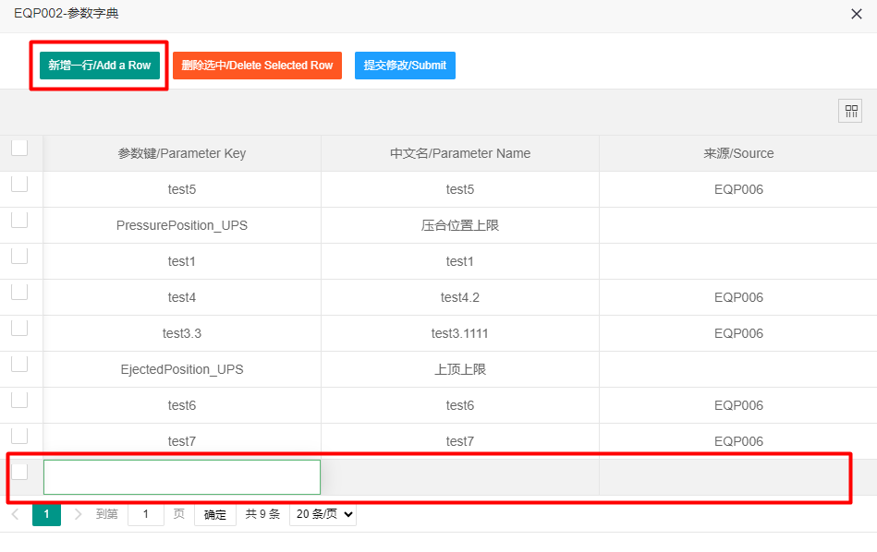
3.1 Parameter management (For Non-Secs machine)(1/3)
Add a reference dictionary:
Click Add Row and fill in the parameter key and parameter name in the new row below the table
*The parameter key must be the same as in the Recipe.
*SMD will confirm the parameter key with the ME engineer in advance when connecting with the Vendor.

Slide 12
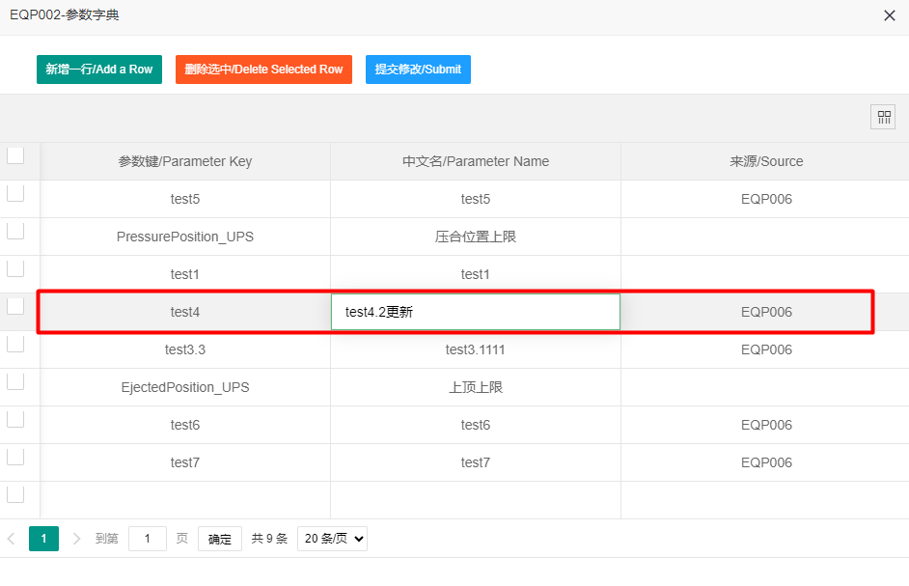
3.1 Parameter management (For Non-Secs machine)(1/3)
Modify the content of the original parameter key:
Click the table cell to be modified and enter the modified contents
Once you have completed all the required actions, click "Submit Changes" for the changes to take effect. If you close the window directly, all modifications are lost.

Slide 13
3.2 Parameter management (For Non-Secs machine)(1/3)
Modify the content of the original parameter key:
Click the table cell to be modified and enter the modified contents
Once you have completed all the required actions, click "Submit Changes" for the changes to take effect. If you close the window directly, all modifications are lost.

